Slide 1
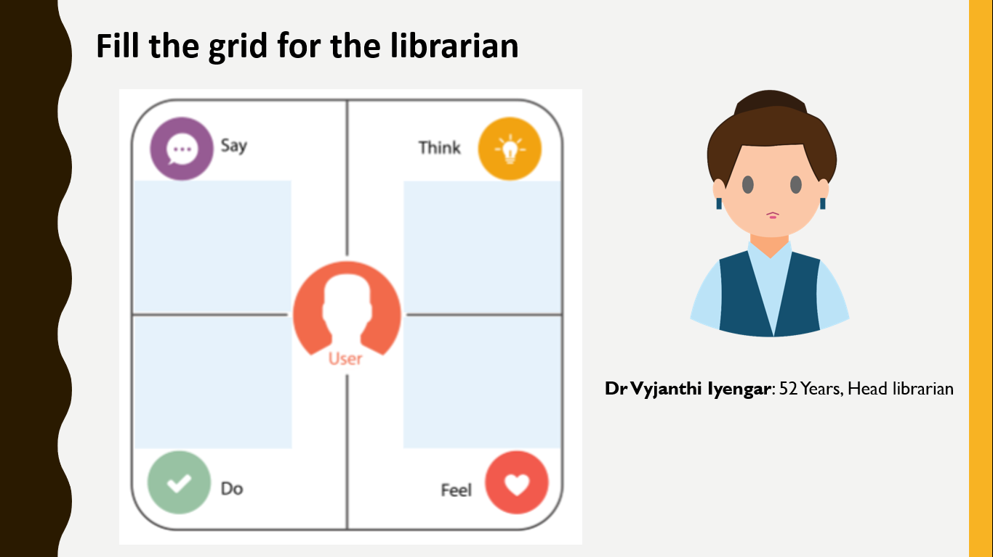
“The library is big and spacious.”
“It has a good collection of text and reference books.”
The library needs some more chairs and tables for the visitors.
We need to increase digital catalogs.
Often used to read books and newspapers in the library, when here are no visitors.
Arrange the books on proper shelves.
Even though the library has all the facilities needed for the students then why the students are not coming to the library?

